Slide 1
Quality Control & Management

Slide 2
Introduction
Definition
Quality refers to the characteristic of a product or service that defines its ability to consistently meet or exceed customer expectations.
Q = P / E
Q = Quality
P = Performance
E = Expectation
"Fitness for use". Fitness is defined by the customer. Which typically means its Performance, Conformance, Durability, Safety, Reliability.

Slide 3
Quality
Producer’s Perspective
Consumer’s Perspective
Quality of Conformance
Quality of Design
Production
Marketing
Conformance to Specification
Cost
Quality Characteristics
Price
Fitness for Consumer Use

Slide 4
Consequence of Poor Quality
Lower productivity, rework, rejection
Loss of productive time
Loss of material
Loss of business organization image
Liability warranty, replacement, repair

Slide 5
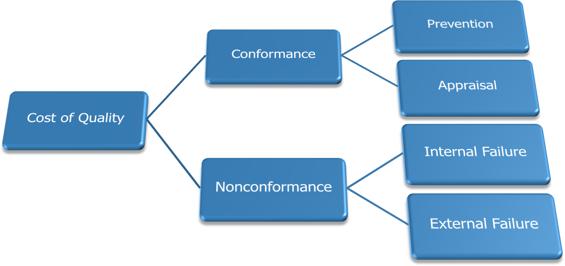
Cost of Quality
Classification of Cost of Quality

Slide 6

Basic Tools of Quality
Seven Basic Tools of Quality is a designation given to a fixed set of graphical techniques identified as being most helpful in troubleshooting issues related to quality.
They are called basic because they are suitable for people with little formal training in statistics and because they can be used to solve the vast majority of quality-related issues.

Slide 7
Seven Basic Tools of Quality
Check Sheet
Stratification Analysis
Control Chart
Pareto Chart
Scatter Diagram
Cause and Effect Diagram
Histogram

Slide 8

Check Sheet
A generic Tool which can be used for collection and analysis of data – A structured and prepared form that can be adapted for wide variety of issues
When to Use a Check Sheet
When data can be observed and collected repeatedly by the same person or at the same location
When collecting data on the frequency or patterns of events,
problems, defects, defect location, defect causes
When collecting data from a production process

Slide 9
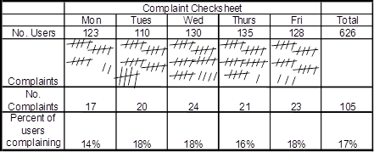
Example of Check Sheet

Slide 10
Stratification Analysis
Stratification is a technique used in combination with other analysis tools. When data from variety if source have been lumped together, meaning of the data can be impossible to see. This techniques separate the data
When to Use Stratification Analysis
Before collecting data
When data come from different source or condition, such as
shifts, days of the week, supplier groups
When data analysis may require separating different sources or condition

Slide 11
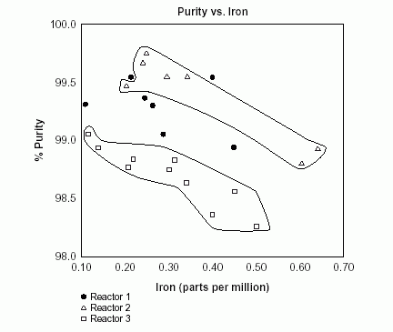
Example of Stratification

Slide 12
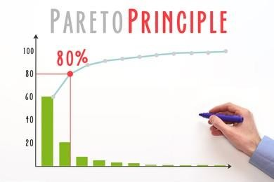
Pareto Chart
A graphical technique used to identify the significance of individual factors
When to Use a Pareto chart
When analyzing data about the frequency of problems or causes in a process
When there are many problems or causes and you want to focus on
the most significant
When analyzing broad causes by looking at their specific components
When communicating with others about your data

Slide 13
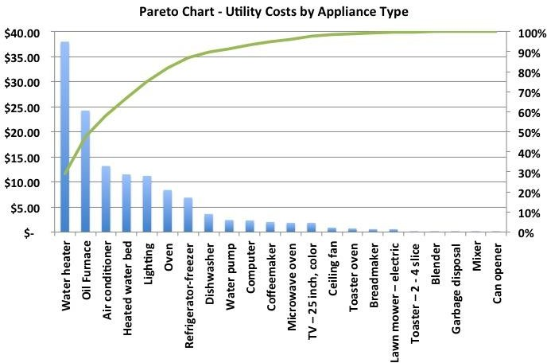
Example of Pareto Chart

Slide 14
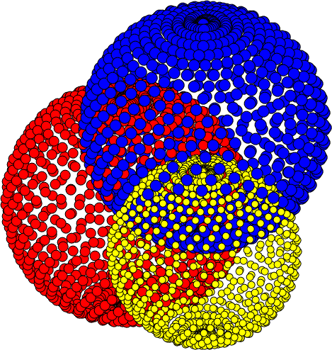
Scatter Diagram
Used to identify the relation between variables, by plotting pairs of numerical data, with one variable on each axis
When to Use a Scatter Diagram
When you have paired numerical data
When your dependent variable may have multiple values for each
value of your independent variable
When trying to determine whether the two variables are related
When trying to identify potential root causes of problems
When determining whether two effects that appear to be related both occur with the same cause
When testing for autocorrelation before constructing a control chart

Slide 15
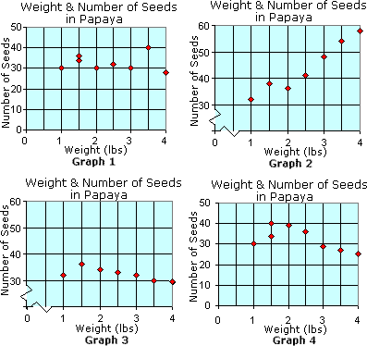
Example of Scatter Diagram

Slide 16

Cause and Effect Diagram
Also called Ishikawa or Fishbone Diagram
Used to structure the brain Storming Session – to sort ideas
into useful categories
Many Possible Causes are identified for a stated problem and the effect on the problem are identified
When to Use a Cause and Effect Diagram
When identifying possible causes for a problem
Especially when a team’s thinking tends to fall into ruts

Slide 17
Types of CE Diagram
Cause Enumeration
Process Analysis
Cause Enumeration: identifies all possible causes from brainstorming sessions and then classifies into groups
Process analysis: follows the process step by step and causes are listed as per process step

Slide 18
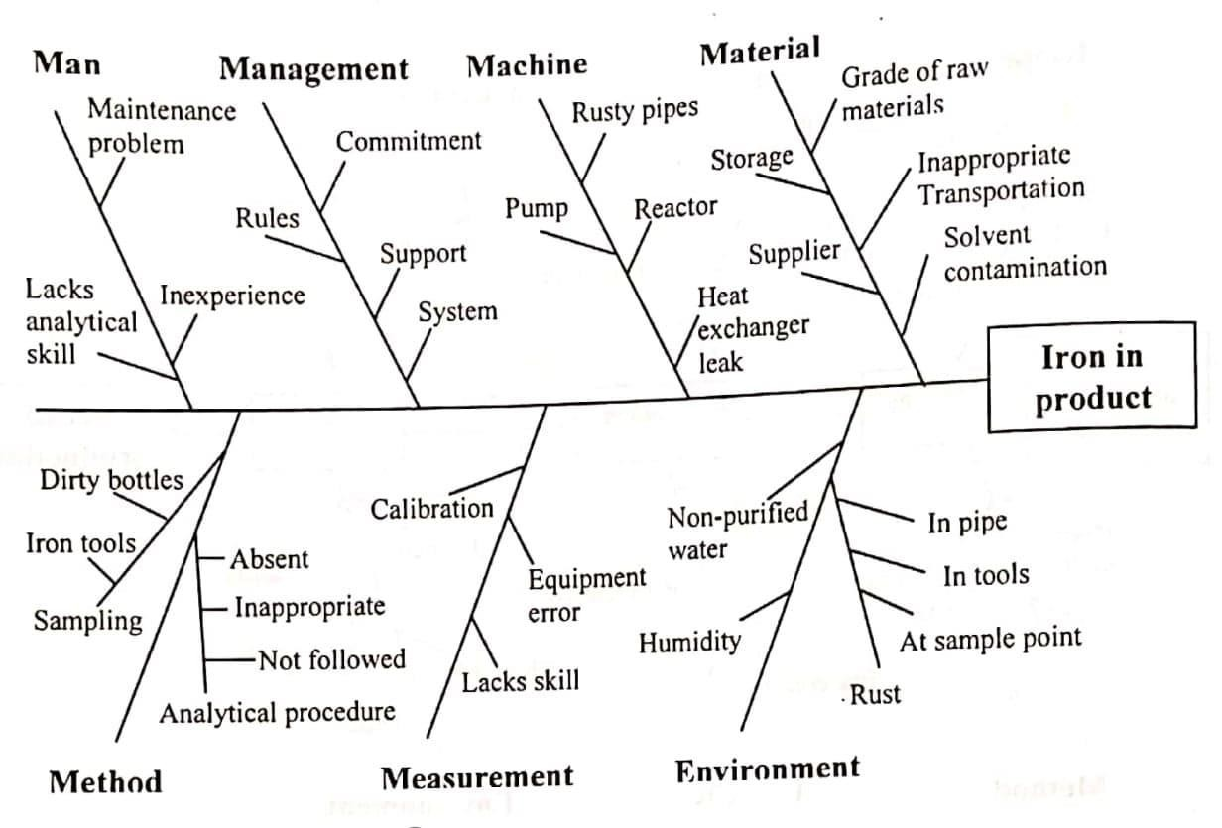
Example of Cause Enumeration

Slide 19
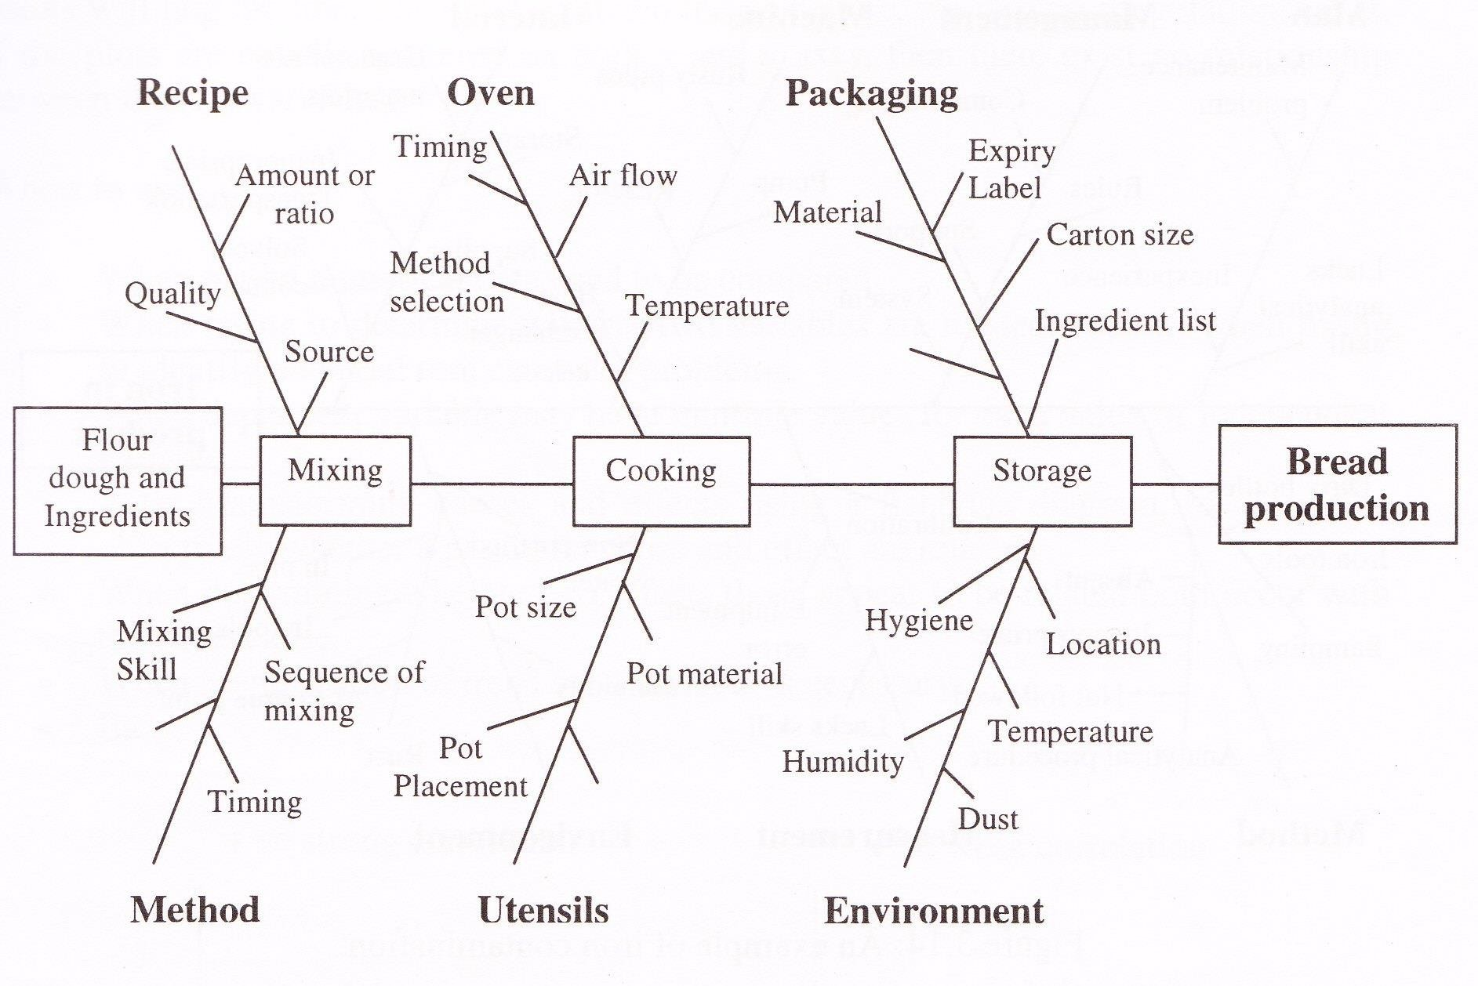
Example of Process Analysis

Slide 20

Histogram
Used to identify the frequency of occurrence of a variable in a set of data – looks very much like a bar chart
When to Use a Histogram
When the data are numerical
When you want to see the shape of the data’s distribution, especially when determining whether the output of a process is distributed approximately normally
When analyzing what the output from a supplier’s process looks like
When seeing whether a process change has occurred from one time period to another
When determining whether the outputs of two or more processes are different
When you wish to communicate the distribution of data quickly and easily to others

Slide 21
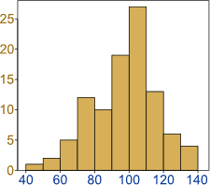
Example of Histogram

Slide 22
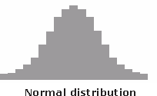
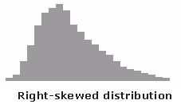
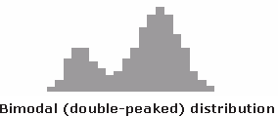
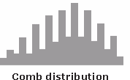
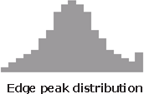
Typical shapes of Histogram

Slide 23

Control Charts
A graphical technique to study the changes to a process
over time
When to Use a Control Chart
When controlling ongoing processes by finding and correcting problems as they occur
When predicting the expected range of outcomes from a process
When determining whether a process is stable (in statistical control)
When analyzing patterns of process variation from special causes
(non-routine events) or common causes (built into the process)
When determining whether your quality improvement project should aim to prevent specific problems or to make fundamental changes to the process

Slide 24
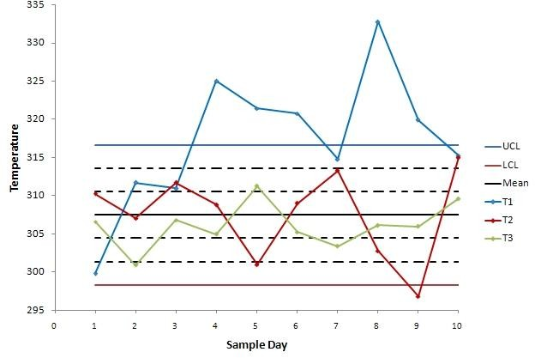
Control Charts

Slide 25
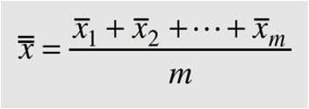


Control Charts for Variables
X-R Chart
20-25 samples are taken usually each of which contains 4-6 observations
If m samples are taken and m observations are made in each sample then the best estimator of process mean is the grand average.
Where are the average of each sample
If x1, x2, . . . , xn is the observations for sample size n, then the range of the sample is the difference between the largest and smallest observations; that is,

Slide 26
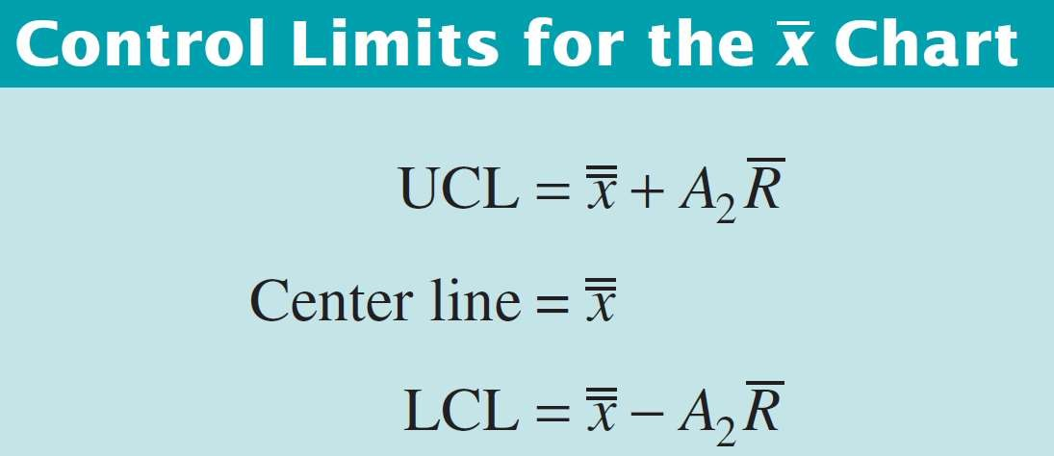
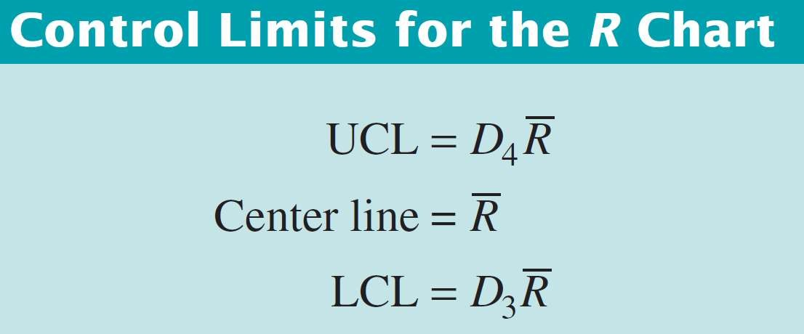
Control Charts for Variables

Slide 27
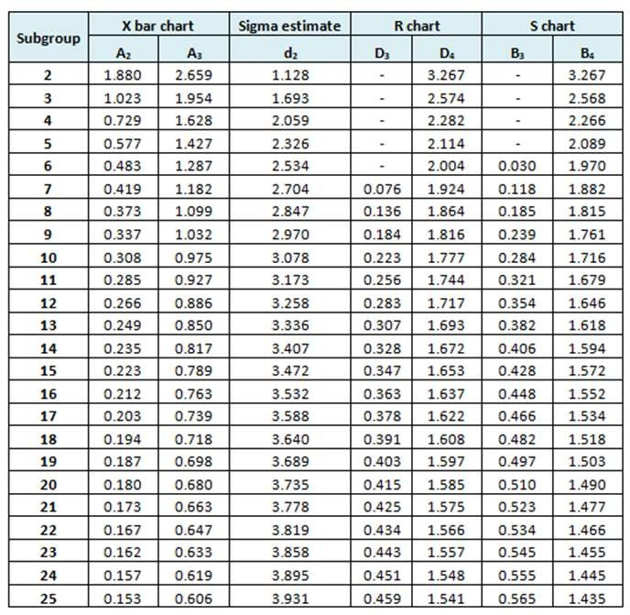
Control Charts Factors

Slide 28
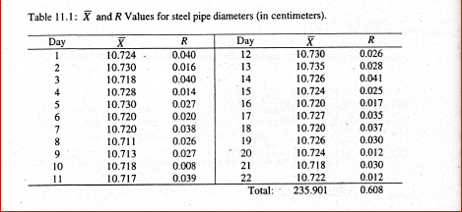
Control Chart Example

Slide 29
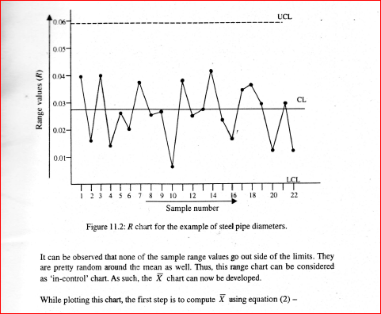
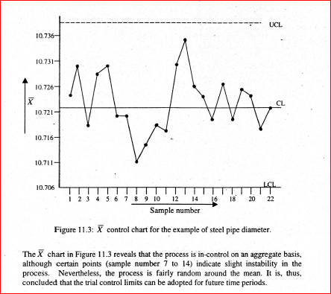

Slide 30
Thank You!
Reference: Quality Control and Management(1st edition) By Ahsan Akhter Hasin

